Slide 1




Bootcamp
Skills Test
HA UG
2022

Slide 2






Yield
ORACLE
2023
C7081
2021

Slide 3









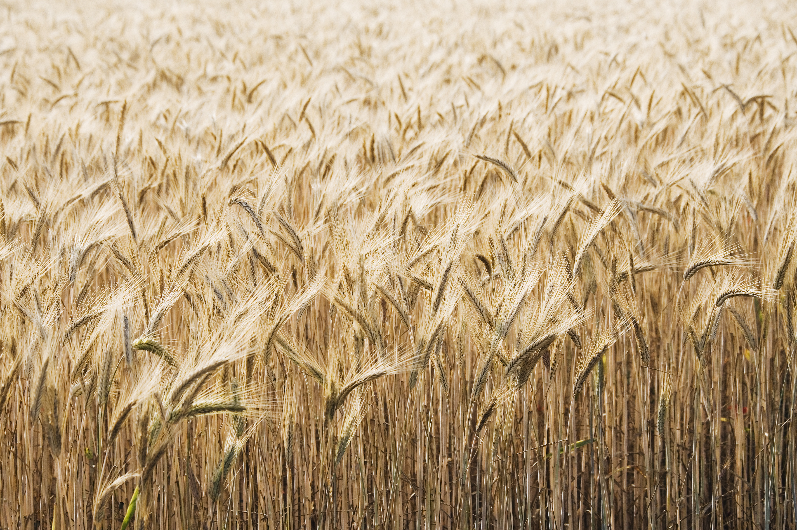


















Slide 4


Q
C7081
2021
antine

Slide 5
Q
antine
Q
antine

Slide 6


HARPE
D
D
HARPE
HARPE
T
T
A
A
2021
HA UG!
D
HARPE
T
2021
A

Slide 7
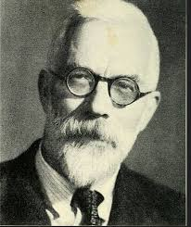

HARPE
HARPE
DATA
SCIENCE
HARPE
HARPE
DATA
SCIENCE

Slide 8

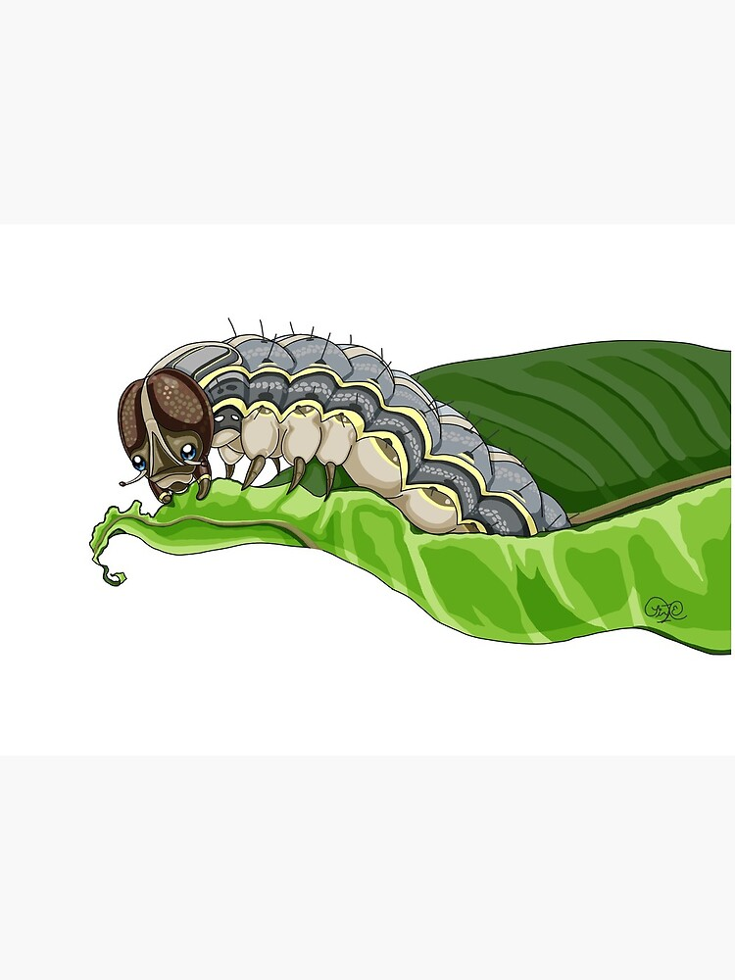
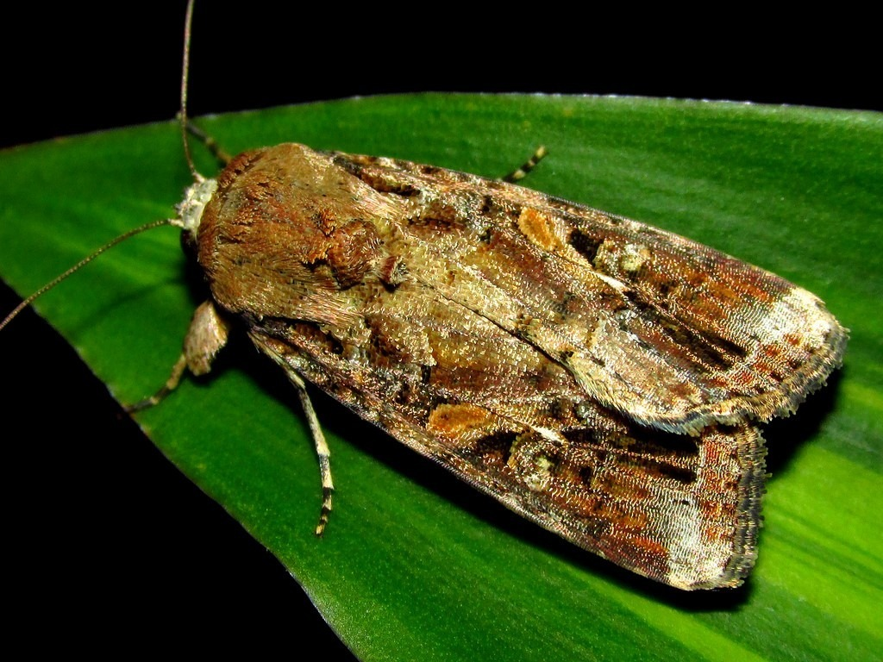






DS
EDA
2021
GA
AGE
DS
2021
DATA
SCIENCE
DS
GA
AGE

Slide 9




Slide 10
Viz!
Non-linear
HA UG
2022

Slide 11
Oh my!
Loops and lmer
HA UG
2022

Slide 12
Ch 04
Spatial Data
HA UG
2022

Slide 13
Ch 03
Spatial Data
HA UG
2022

Slide 14
Ch 01-02
Spatial Data
HA UG
2022

Slide 15
{leaflet}
Maps in R
HA UG
2022

Slide 16
Ch 03
Advanced R
HA UG
2022

Slide 17
Scrape the
Web!
Twitter data
HA UG
2022

Slide 18
Keras
in R!
Deep Learning
HA UG
2022

Slide 19
Control structures
and flow!
R programming
HA UG
2022

Slide 20
Memory use
Advanced R
HA UG
2022

Slide 21
Yolov5 for
Custom data!
HARPE
DATA
SCIENCE

Slide 22
Using SADIE
in R
Spatial data
HA UG
2022

Slide 23
Big Data Projects
HARPE
DATA
SCIENCE

Slide 24
Web Automation in R
Automation
HA UG
2022

Slide 25
Web Automation in R
Automation
HA UG
2022

Slide 26

Github webpage
R analysis

Slide 27
LME + blocking
R analysis

Slide 28


Data Viz

Slide 30
NLP
Sentiment analysis
HARPE
DATA
SCIENCE

Slide 31
Sample size?
R simulation

Slide 32
NLP basics
HARPE
DATA
SCIENCE

Slide 33
T-test
R Bootcamp
2.5

Slide 34
Regression
R Bootcamp
2.4

Slide 35
Correlation
R Bootcamp
2.3

Slide 36
Distributions
R Bootcamp
2.2

Slide 37
summarizing
data
R Bootcamp
2.1
HARPE
DATA
SCIENCE

Slide 38
HAP-E
Machine learning
concept
HARPE
DATA
SCIENCE

Slide 39
HAP-E
Stats basics
HARPE
DATA
SCIENCE

Slide 40
HAP-E
Data wrangling
HARPE
DATA
SCIENCE

Slide 41
HAP-E
Python graphs
HARPE
DATA
SCIENCE

Slide 42
HAP-E
Python setup
HARPE
DATA
SCIENCE

Slide 43
manipulating
data
R Bootcamp
1.5
HARPE
DATA
SCIENCE

Slide 44
R Bootcamp
1.4
HARPE
DATA
SCIENCE

Slide 45
R Bootcamp
1.3
HARPE
DATA
SCIENCE

Slide 46
Github
Website
HARPE
HARPE
DATA
SCIENCE
SCIENCE

Slide 47


R Bootcamp
0.0 overview
HARPE
HARPE
DATA
SCIENCE
SCIENCE

Slide 48
R Bootcamp
0.1 RStudio
HARPE
HARPE
DATA
SCIENCE
SCIENCE

Slide 49
R Bootcamp
1.1 R Syntax
HARPE
HARPE
DATA
SCIENCE
SCIENCE

Slide 50
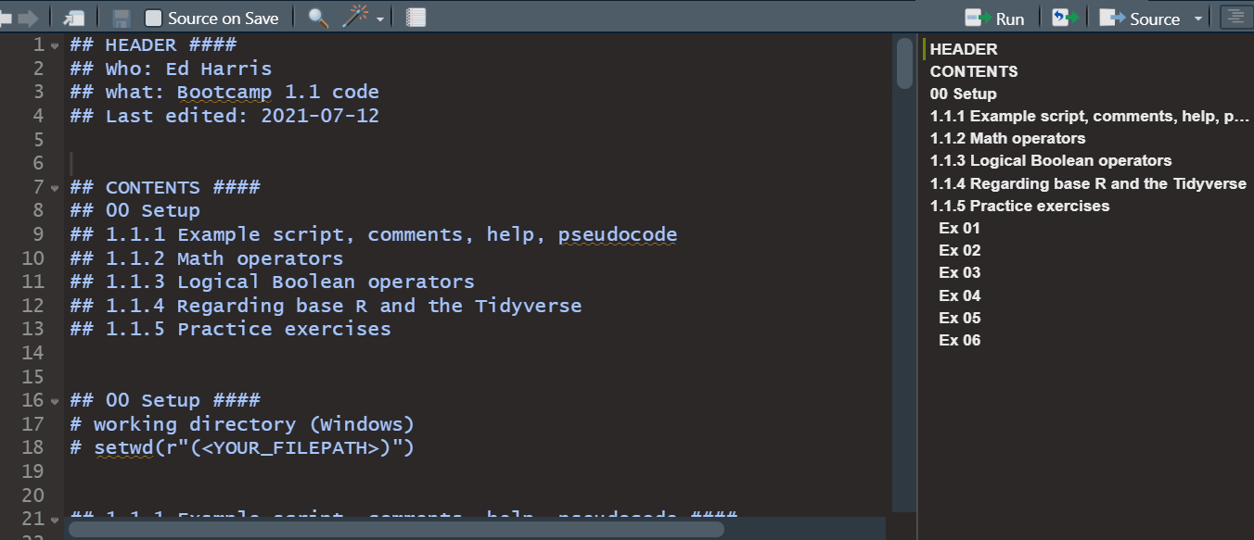
R Bootcamp
1.1 R Syntax
HARPE
HARPE
DATA
SCIENCE
SCIENCE

Slide 51
R Bootcamp
1.2 Functions
HARPE
HARPE
DATA
SCIENCE
SCIENCE

Slide 52
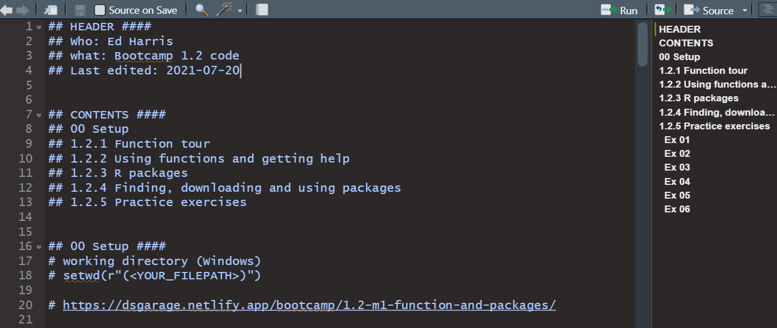
R Bootcamp
1.2 Functions
HARPE
HARPE
DATA
SCIENCE
SCIENCE

Slide 53

shinycustomloader
shinycustomloader
shinycustomloader
shinycustomloader
shinycustomloader
shinycustomloader
shinycustomloader
shinycustomloader
http://hexb.in/sticker.html

